Slide 1
Strong Induction
CMSC 250

Slide 2
Strong Induction: The principle
Let us recall the weak induction principle for a moment

Slide 3
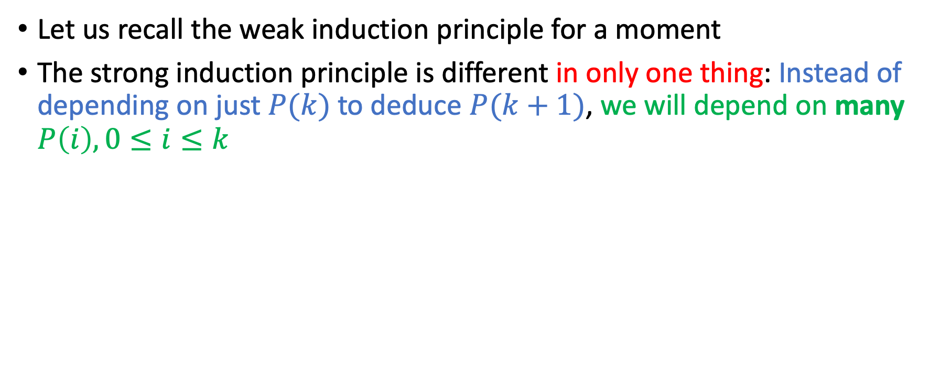
Strong Induction: The principle
Let us recall the weak induction principle for a moment
The strong induction principle is different in only one thing: Instead of depending on just $P(k)$ to deduce $P(k+1)$, we will depend on many $P\left(i\right), 0≤i≤k$

Slide 4


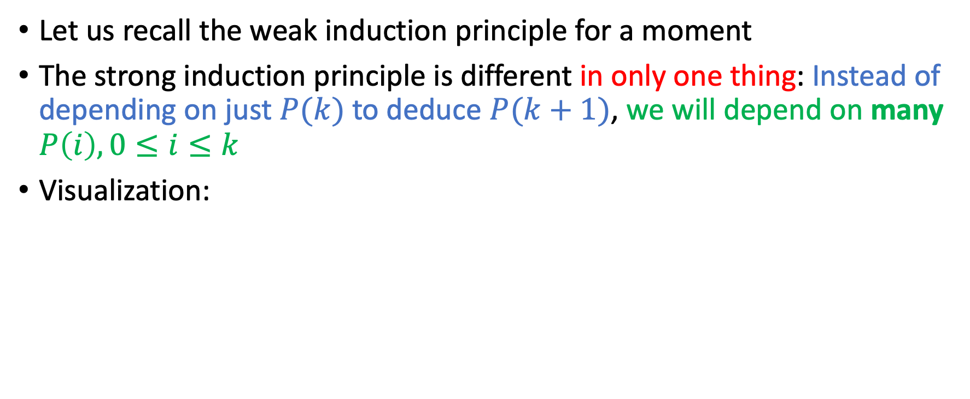
Strong Induction: The principle
Let us recall the weak induction principle for a moment
The strong induction principle is different in only one thing: Instead of depending on just $P(k)$ to deduce $P(k+1)$, we will depend on many $P\left(i\right), 0≤i≤k$
Visualization:
Weak Induction | Strong Induction

Slide 5

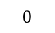

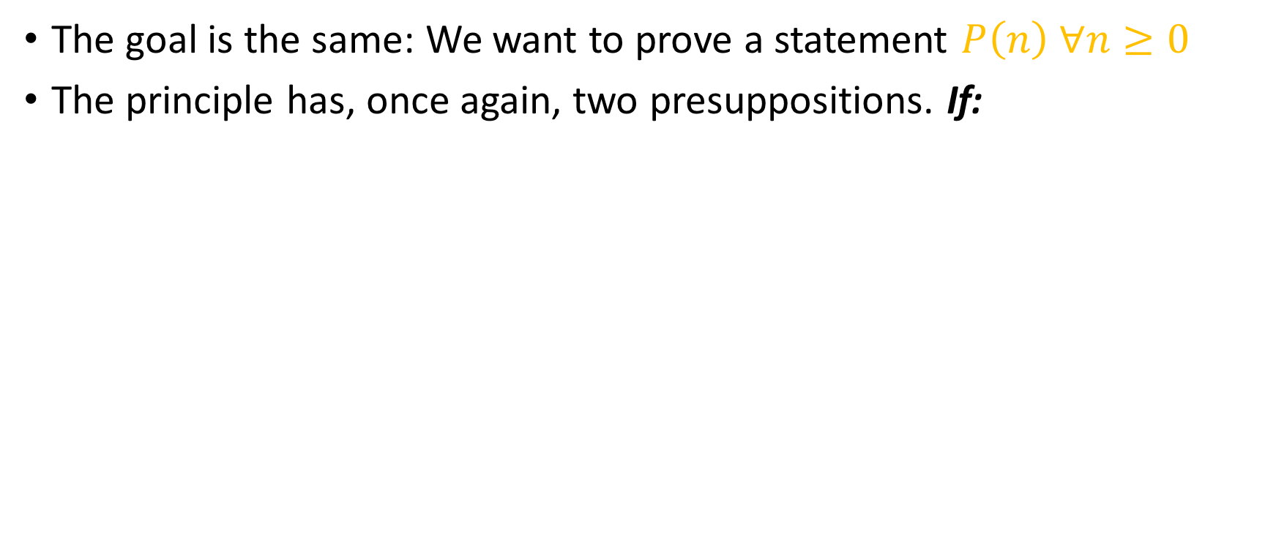


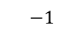

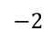
Strong Induction: The principle
The goal is the same: We want to prove a statement $P\left(n\right) ∀n≥0$
The principle has, once again, two presuppositions. If:
$$…$$
$$…$$
$$−2$$
$$−1$$
$$0$$
$$1$$
$$2$$
$$…$$

Slide 6
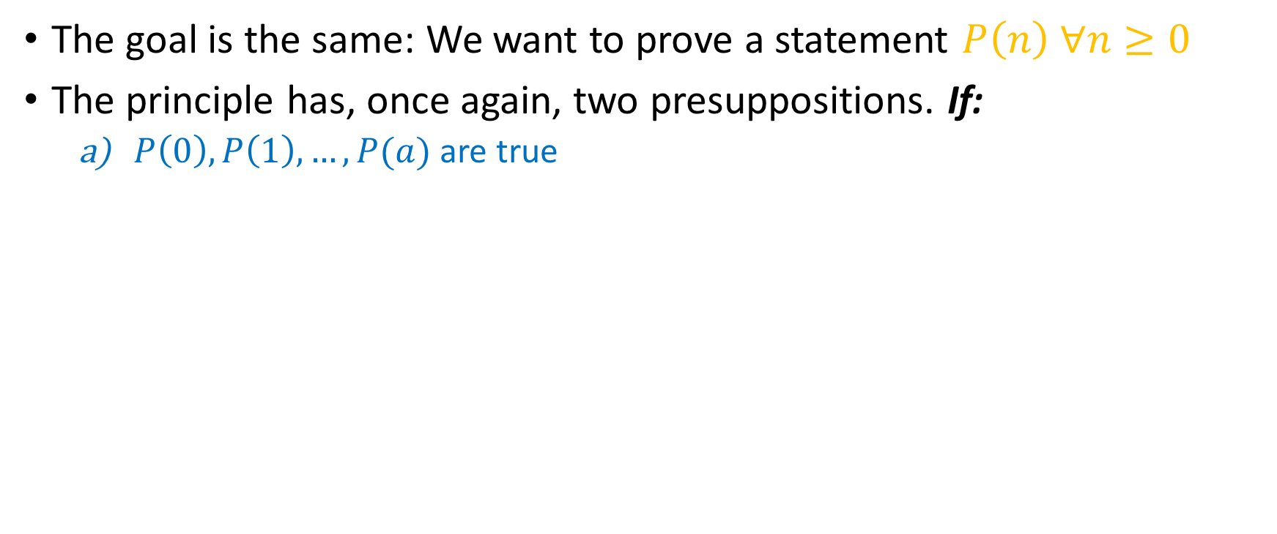
Strong Induction: The principle
The goal is the same: We want to prove a statement $P\left(n\right) ∀n≥0$
The principle has, once again, two presuppositions. If:
$P\left(0\right),P\left(1\right), …,P(a)$are true
$$…$$
$$…$$
$$−2$$
$$0$$
$$1$$
$$…$$
a
$$−1$$
$$2$$

Slide 7
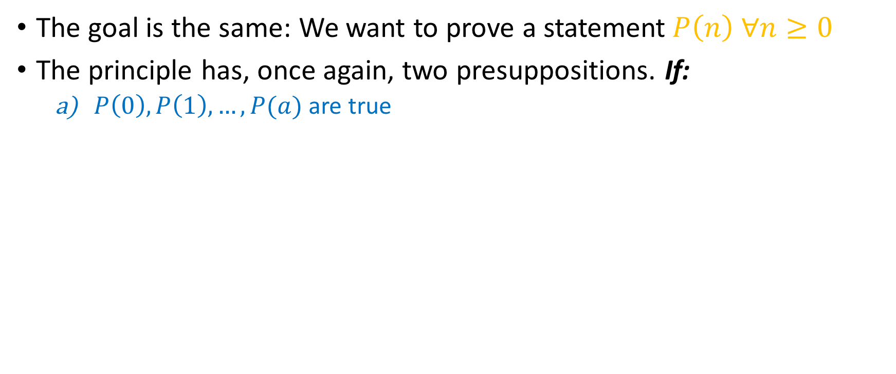
Strong Induction: The principle
The goal is the same: We want to prove a statement$P\left(n\right) ∀n≥0$
The principle has, once again, two presuppositions. If:
$P\left(0\right),P\left(1\right), …,P(a)$are true
$$…$$
$$…$$
$$−2$$
$$0$$
$$1$$
$$…$$
a
$$−1$$
$$2$$

Slide 8
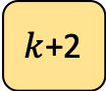

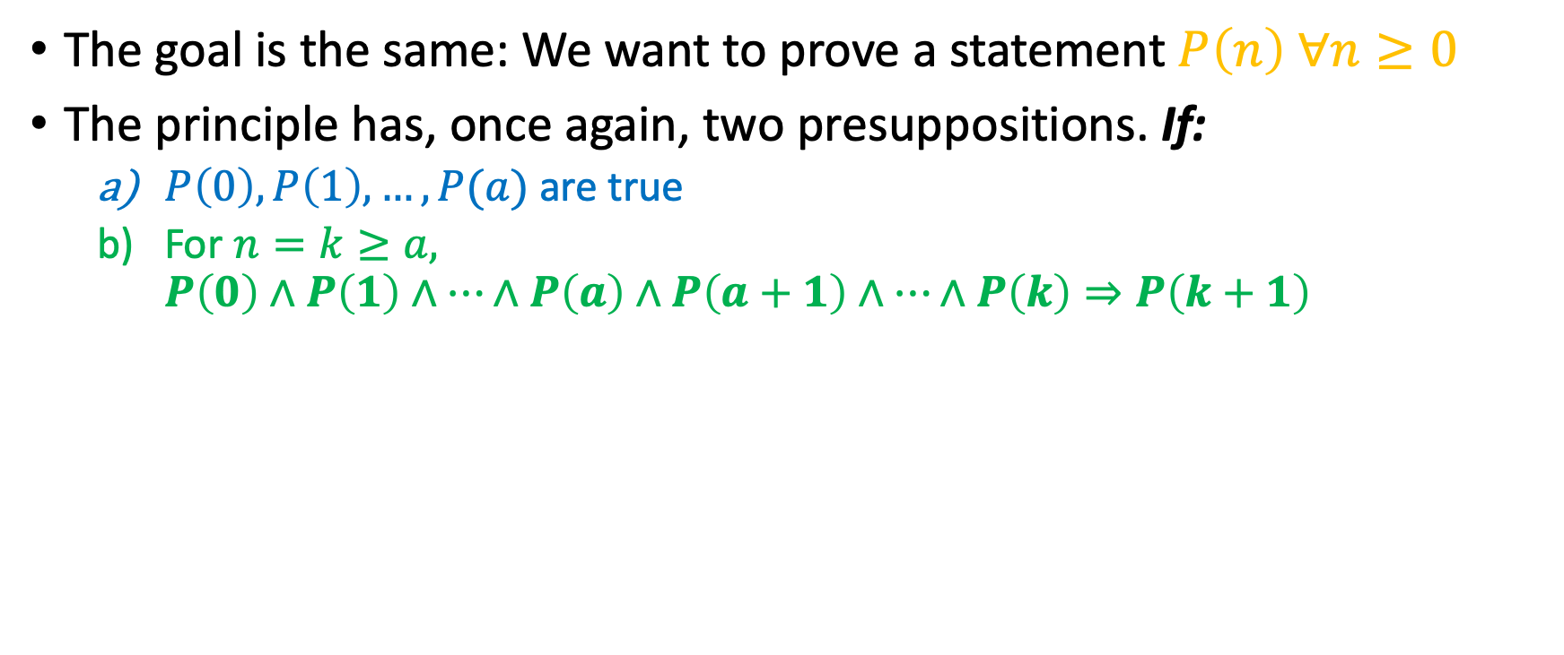
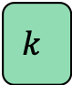
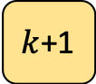
Strong Induction: The principle
The goal is the same: We want to prove a statement $P\left(n\right) ∀n≥0$
The principle has, once again, two presuppositions. If:
$P\left(0\right),P\left(1\right), …,P(a)$are true
For $n=k≥a,$
$$P\left(0\right)∧P\left(1\right)∧…∧P\left(a\right)∧P\left(a+1\right)∧…∧P\left(k\right)⇒P\left(k+1\right)$$
$$0$$
$$…$$
a
$$…$$
$$k$$
$k$+1
$k$+2
$$…$$
$$…$$
$$−2$$
$$−1$$
$$1$$
$$2$$

Slide 9

Strong Induction: The principle
The goal is the same: We want to prove a statement$P\left(n\right) ∀n≥0$
The principle has, once again, two presuppositions. If:
$P\left(0\right),P\left(1\right), …,P(a)$are true
For $n=k≥a,$
$$P\left(0\right)∧P\left(1\right)∧…∧P\left(a\right)∧P\left(a+1\right)∧…∧P\left(k\right)⇒P\left(k+1\right)$$
$$0$$
$$…$$
a
$$…$$
$$k$$
$k$+1
$k$+2
$$…$$
$$…$$
$$−2$$
$$−1$$
$$1$$
$$2$$

Slide 10
Strong Induction: The principle
The goal is the same: We want to prove a statement$P\left(n\right) ∀n≥0$
The principle has, once again, two presuppositions. If:
$P\left(0\right),P\left(1\right), …,P(a)$are true
For $n=k≥a,$
$$P\left(0\right)∧P\left(1\right)∧…∧P\left(a\right)∧P\left(a+1\right)∧…∧P\left(k\right)⇒P\left(k+1\right)$$
$$0$$
$$…$$
a
$$…$$
$$k$$
$k$+1
$k$+2
$$…$$
$$…$$
$$−2$$
$$−1$$
$$1$$
$$2$$

Slide 11
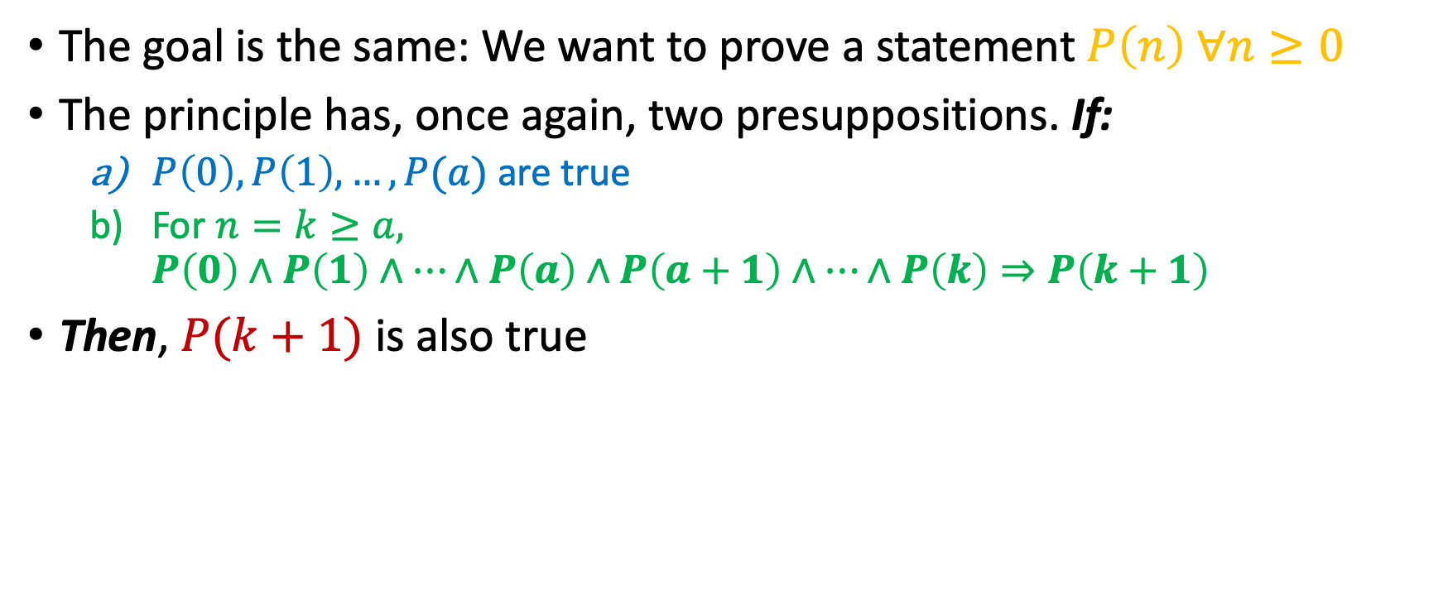
Strong Induction: The principle
The goal is the same: We want to prove a statement$P\left(n\right) ∀n≥0$
The principle has, once again, two presuppositions. If:
$P\left(0\right),P\left(1\right), …,P(a)$are true
For $n=k≥a,$
$$P\left(0\right)∧P\left(1\right)∧…∧P\left(a\right)∧P\left(a+1\right)∧…∧P\left(k\right)⇒P\left(k+1\right)$$
Then, $P(k+1)$ is also true
$$0$$
$$…$$
a
$$…$$
$$k$$
$k$+1
$k$+2
$$…$$
$$…$$
$$−2$$
$$−1$$
$$1$$
$$2$$

Slide 12
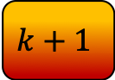
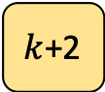
Strong Induction: The principle
The goal is the same: We want to prove a statement$P\left(n\right) ∀n≥0$
The principle has, once again, two presuppositions. If:
$P\left(0\right),P\left(1\right), …,P(a)$are true
For $n=k≥a,$
$$P\left(0\right)∧P\left(1\right)∧…∧P\left(a\right)∧P\left(a+1\right)∧…∧P\left(k\right)⇒P\left(k+1\right)$$
Then, $P(k+1)$ is also true
$$0$$
$$…$$
a
$$…$$
$$k$$
$$k+1$$
$k$+2
$$…$$
$$…$$
$$−2$$
$$−1$$
$$1$$
$$2$$

Slide 13
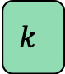
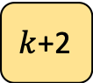


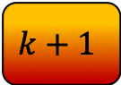
Strong Induction: The principle
The goal is the same: We want to prove a statement $P\left(n\right) ∀n≥0$
The principle has, once again, two presuppositions. If:
$P\left(0\right),P\left(1\right), …,P(a)$are true
For $n=k≥a,$
$$P\left(0\right)∧P\left(1\right)∧…∧P\left(a\right)∧P\left(a+1\right)∧…∧P\left(k\right)⇒P\left(k+1\right)$$
Then, $P(k+1)$ is also true
$$0$$
$$…$$
a
$$…$$
$$…$$
$$k$$
$$k+1$$
$k$+2
$$1$$
$$2$$

Slide 14
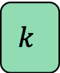
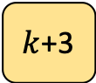
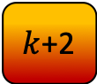

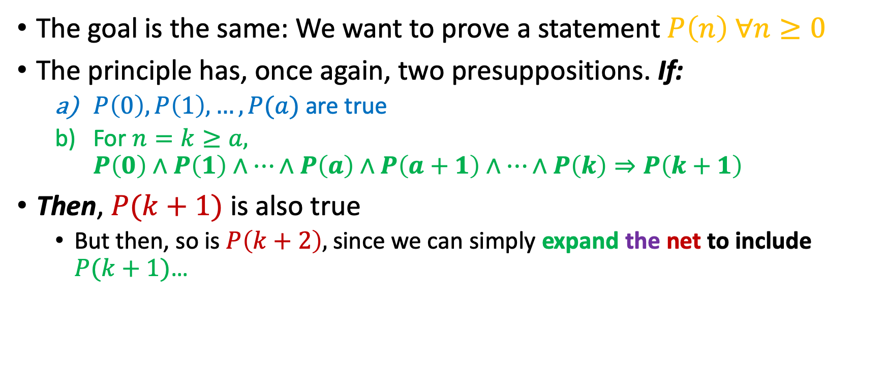
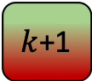
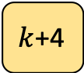
Strong Induction: The principle
The goal is the same: We want to prove a statement $P\left(n\right) ∀n≥0$
The principle has, once again, two presuppositions. If:
$P\left(0\right),P\left(1\right), …,P(a)$are true
For $n=k≥a,$
$$P\left(0\right)∧P\left(1\right)∧…∧P\left(a\right)∧P\left(a+1\right)∧…∧P\left(k\right)⇒P\left(k+1\right)$$
Then, $P(k+1)$ is also true
But then, so is $P\left(k+2\right),$ since we can simply expand the net to include $P(k+1)$…
$$0$$
$$…$$
a
$$…$$
$$…$$
$$k$$
$k$+1
$k$+2
$k$+3
$k$+4
$$…$$
$$1$$
$$2$$

Slide 15
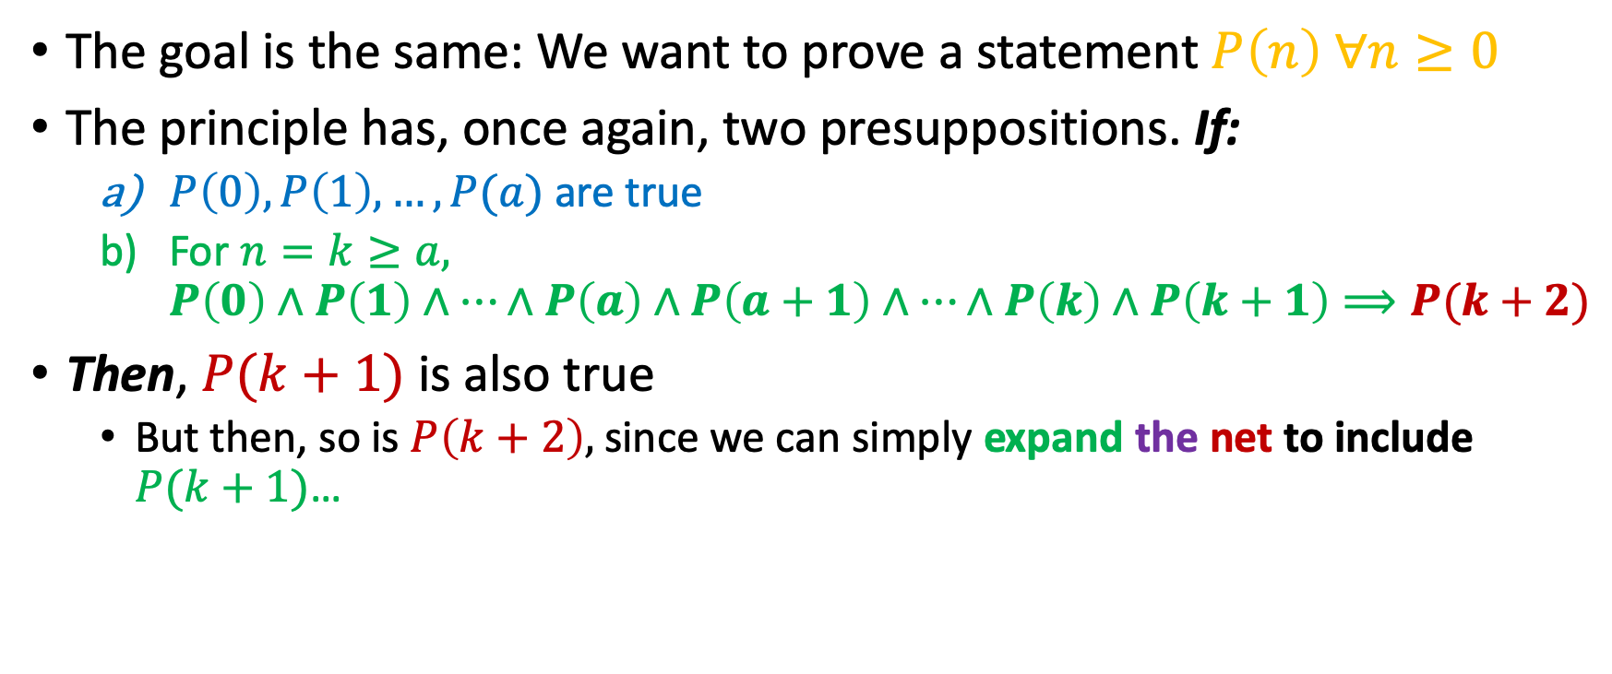
Strong Induction: The principle
The goal is the same: We want to prove a statement $P\left(n\right) ∀n≥0$
The principle has, once again, two presuppositions. If:
$P\left(0\right),P\left(1\right), …,P(a)$are true
For $n=k≥a,$
$$P\left(0\right)∧P\left(1\right)∧…∧P\left(a\right)∧P\left(a+1\right)∧…∧P\left(k\right)∧P\left(k+1\right)⟹P(k+2)$$
Then, $P(k+1)$ is also true
But then, so is $P\left(k+2\right),$ since we can simply expand the net to include $P(k+1)$…
$$0$$
$$…$$
a
$$…$$
$$…$$
$$k$$
$k$+1
$k$+2
$k$+3
$k$+4
$$…$$
$$1$$
$$2$$

Slide 16

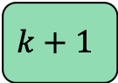
Strong Induction: The principle
The goal is the same: We want to prove a statement $P\left(n\right) ∀n≥0$
The principle has, once again, two presuppositions. If:
$P\left(0\right),P\left(1\right), …,P(a)$are true
For $n=k≥a,$
$$P\left(0\right)∧P\left(1\right)∧…∧P\left(a\right)∧P\left(a+1\right)∧…∧P\left(k\right)∧P\left(k+1\right)⟹P(k+2)$$
Then, $P(k+1)$ is also true
But then, so is $P\left(k+2\right),$ since we can simply expand the net to include $P(k+1)$…
$$0$$
$$…$$
a
$$…$$
$$…$$
$$k$$
$$k+1$$
$k$+2
$k$+3
$k$+4
$$…$$
$$1$$
$$2$$

Slide 17
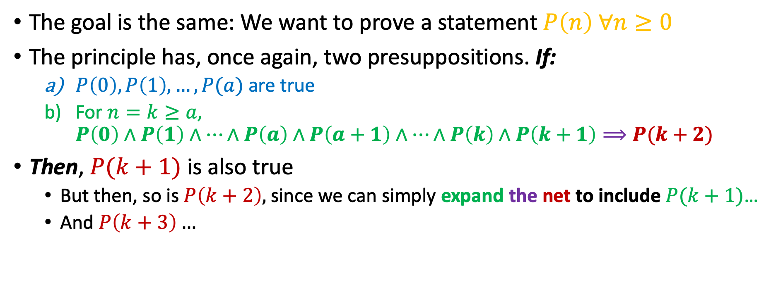
Strong Induction: The principle
The goal is the same: We want to prove a statement $P\left(n\right) ∀n≥0$
The principle has, once again, two presuppositions. If:
$P\left(0\right),P\left(1\right), …,P(a)$are true
For $n=k≥a,$
$$P\left(0\right)∧P\left(1\right)∧…∧P\left(a\right)∧P\left(a+1\right)∧…∧P\left(k\right)∧P\left(k+1\right)⟹P(k+2)$$
Then, $P(k+1)$ is also true
But then, so is $P\left(k+2\right),$ since we can simply expand the net to include $P(k+1)$…
And $P\left(k+3\right)…$
$$0$$
$$…$$
a
$$…$$
$$…$$
$$k$$
$$k+1$$
$k$+2
$k$+3
$k$+4
$$…$$
$$1$$
$$2$$

Slide 18
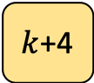

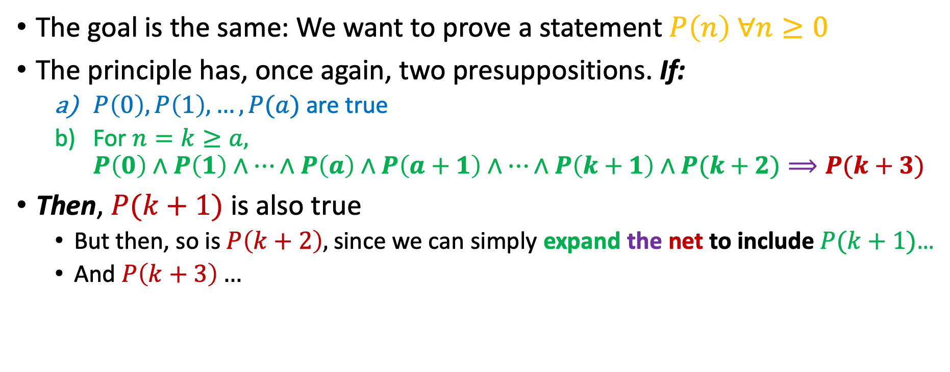
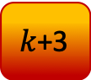
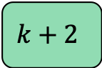
Strong Induction: The principle
The goal is the same: We want to prove a statement $P\left(n\right) ∀n≥0$
The principle has, once again, two presuppositions. If:
$P\left(0\right),P\left(1\right), …,P(a)$are true
For $n=k≥a,$
$$P\left(0\right)∧P\left(1\right)∧…∧P\left(a\right)∧P\left(a+1\right)∧…∧P\left(k+1\right)∧P(k+2)⟹P(k+3)$$
Then, $P(k+1)$ is also true
But then, so is $P\left(k+2\right),$ since we can simply expand the net to include $P(k+1)$…
And $P\left(k+3\right)…$
$$0$$
$$…$$
a
$$…$$
$$…$$
$$k$$
$$k+1$$
$$k+2$$
$k$+3
$k$+4
$$…$$
$$1$$
$$2$$

Slide 19
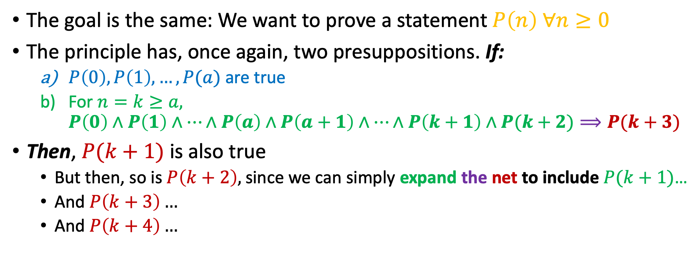
Strong Induction: The principle
The goal is the same: We want to prove a statement $P\left(n\right) ∀n≥0$
The principle has, once again, two presuppositions. If:
$P\left(0\right),P\left(1\right), …,P(a)$are true
For $n=k≥a,$
$$P\left(0\right)∧P\left(1\right)∧…∧P\left(a\right)∧P\left(a+1\right)∧…∧P\left(k+1\right)∧P(k+2)⟹P(k+3)$$
Then, $P(k+1)$ is also true
But then, so is $P\left(k+2\right),$ since we can simply expand the net to include $P(k+1)$…
And $P\left(k+3\right)…$
And $P\left(k+4\right)…$
$$0$$
$$…$$
a
$$…$$
$$…$$
$$k$$
$$k+1$$
$$k+2$$
$k$+3
$k$+4
$$…$$
$$1$$
$$2$$

Slide 20
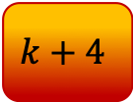


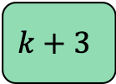
Strong Induction: The principle
The goal is the same: We want to prove a statement $P\left(n\right) ∀n≥0$
The principle has, once again, two presuppositions. If:
$P\left(0\right),P\left(1\right), …,P(a)$are true
For $n=k≥a,$
$$P\left(0\right)∧P\left(1\right)∧…∧P\left(a\right)∧P\left(a+1\right)∧…∧P\left(k+2\right)∧P(k+3)⟹P(k+4)$$
Then, $P(k+1)$ is also true
But then, so is $P\left(k+2\right),$ since we can simply expand the net to include $P(k+1)$…
And $P\left(k+3\right)…$
And $P\left(k+4\right)…$
$$0$$
$$…$$
a
$$…$$
$$…$$
$$k$$
$$k+1$$
$$k+2$$
$$k+3$$
$$k+4$$
$$…$$
$$1$$
$$2$$

Slide 21
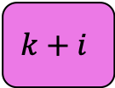
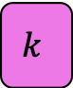
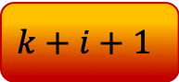
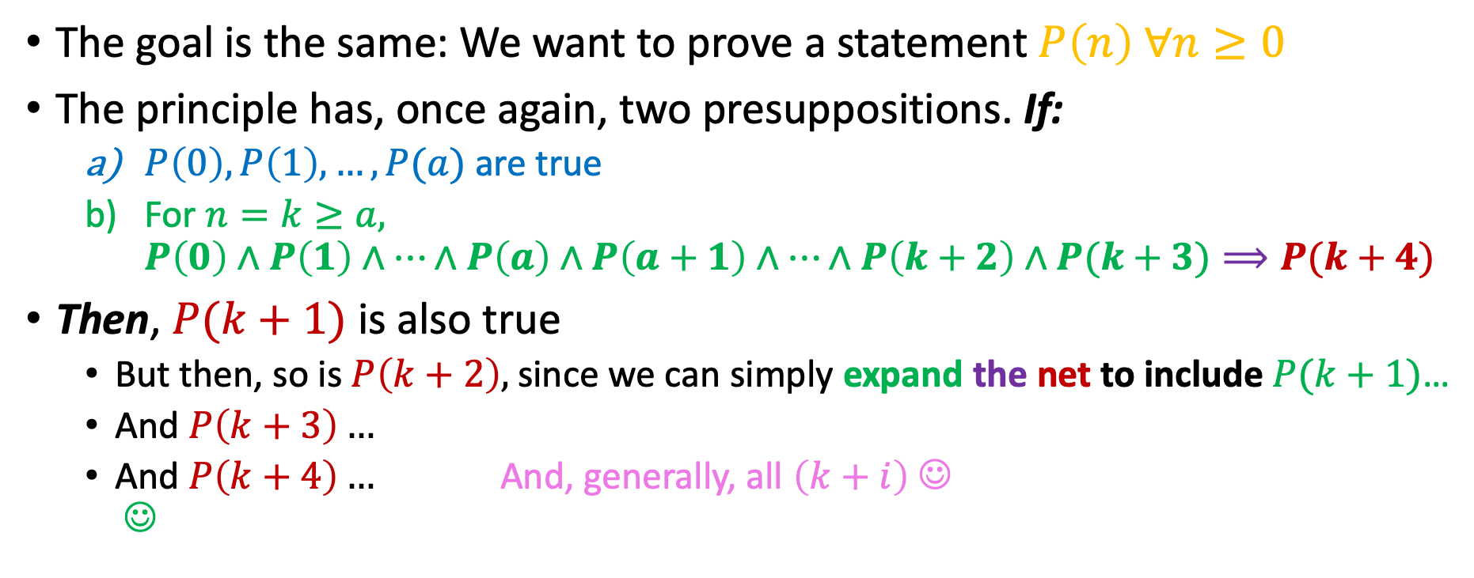

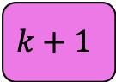
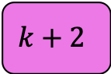
Strong Induction: The principle
The goal is the same: We want to prove a statement $P\left(n\right) ∀n≥0$
The principle has, once again, two presuppositions. If:
$P\left(0\right),P\left(1\right), …,P(a)$are true
For $n=k≥a,$
$$P\left(0\right)∧P\left(1\right)∧…∧P\left(a\right)∧P\left(a+1\right)∧…∧P\left(k+2\right)∧P(k+3)⟹P(k+4)$$
Then, $P(k+1)$ is also true
But then, so is $P\left(k+2\right),$ since we can simply expand the net to include $P(k+1)$…
And $P\left(k+3\right)…$
And $P\left(k+4\right)…$ And, generally, all $\left(k+i\right)$ ☺ ☺
$$0$$
$$…$$
a
$$…$$
$$…$$
$$k$$
$$k+1$$
$$k+2$$
$$….$$
$$k+i$$
$$k+i+1$$
$$1$$
$$2$$

Slide 22
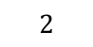
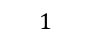

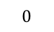
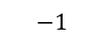

How we’ll make it work
We want to prove a statement $P\left(n\right) ∀n≥0$
$$…$$
$$−2$$
$$0$$
$$1$$
3
…
…
$$−1$$
$$2$$

Slide 23
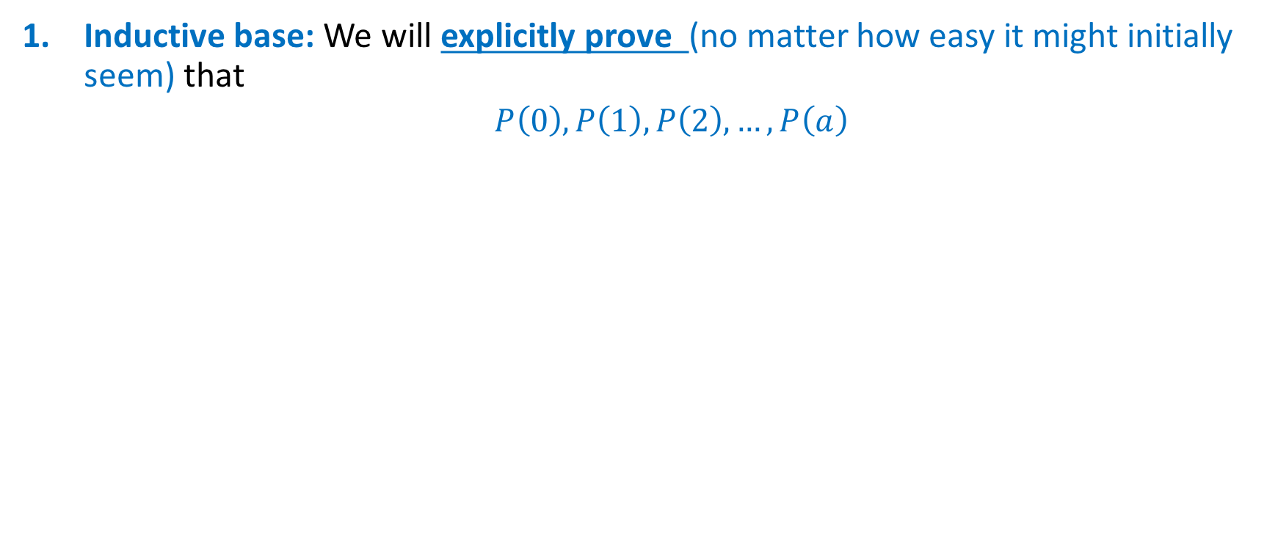

How we’ll make it work
Inductive base: We will explicitly prove (no matter how easy it might initially seem) that
$P\left(0\right), P\left(1\right), P\left(2\right), …, P\left(a\right)$
$$0$$
3
…
a
…
…
$$…$$
$$−2$$
$$−1$$
$$1$$
$$2$$

Slide 24

How we’ll make it work
Inductive base: We will explicitly prove (no matter how easy it might initially seem) that
$P\left(0\right), P\left(1\right), P\left(2\right), …, P\left(a\right)$
$$0$$
3
…
a
…
…
$$…$$
$$−2$$
$$−1$$
$$1$$
$$2$$
“Safety Net” Applied!

Slide 25
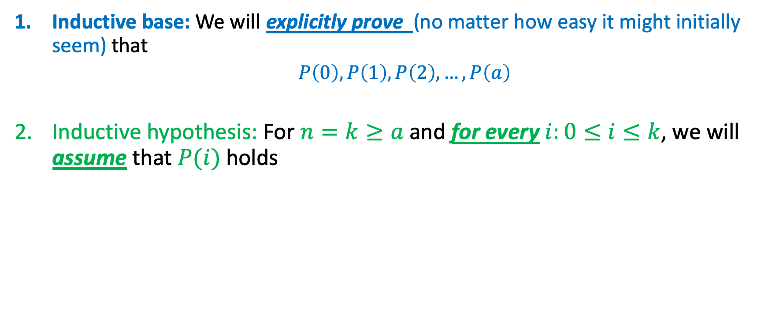
How we’ll make it work
Inductive base: We will explicitly prove (no matter how easy it might initially seem) that
$P\left(0\right), P\left(1\right), P\left(2\right), …, P\left(a\right)$
Inductive hypothesis: For $n=k≥a$ and for every $i:0≤i≤k$, we will assume that $P(i)$ holds
$$0$$
3
…
a
…
…
$$…$$
$$−2$$
$$−1$$
$$1$$
$$2$$
“Safety Net” Applied!

Slide 26
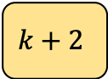
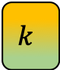
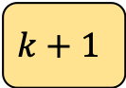
How we’ll make it work
Inductive base: We will explicitly prove (no matter how easy it might initially seem) that
$P\left(0\right), P\left(1\right), P\left(2\right), …, P\left(a\right)$
Inductive hypothesis: For $n=k≥a$ and for every $i:0≤i≤k$, we will assume that $P(i)$ holds
3
…
a
…
$$k$$
$$k+1$$
$$k+2$$
…
$$…$$
$$−2$$
$$−1$$
$$0$$
$$1$$
$$2$$
“Safety Net” Extended!

Slide 27
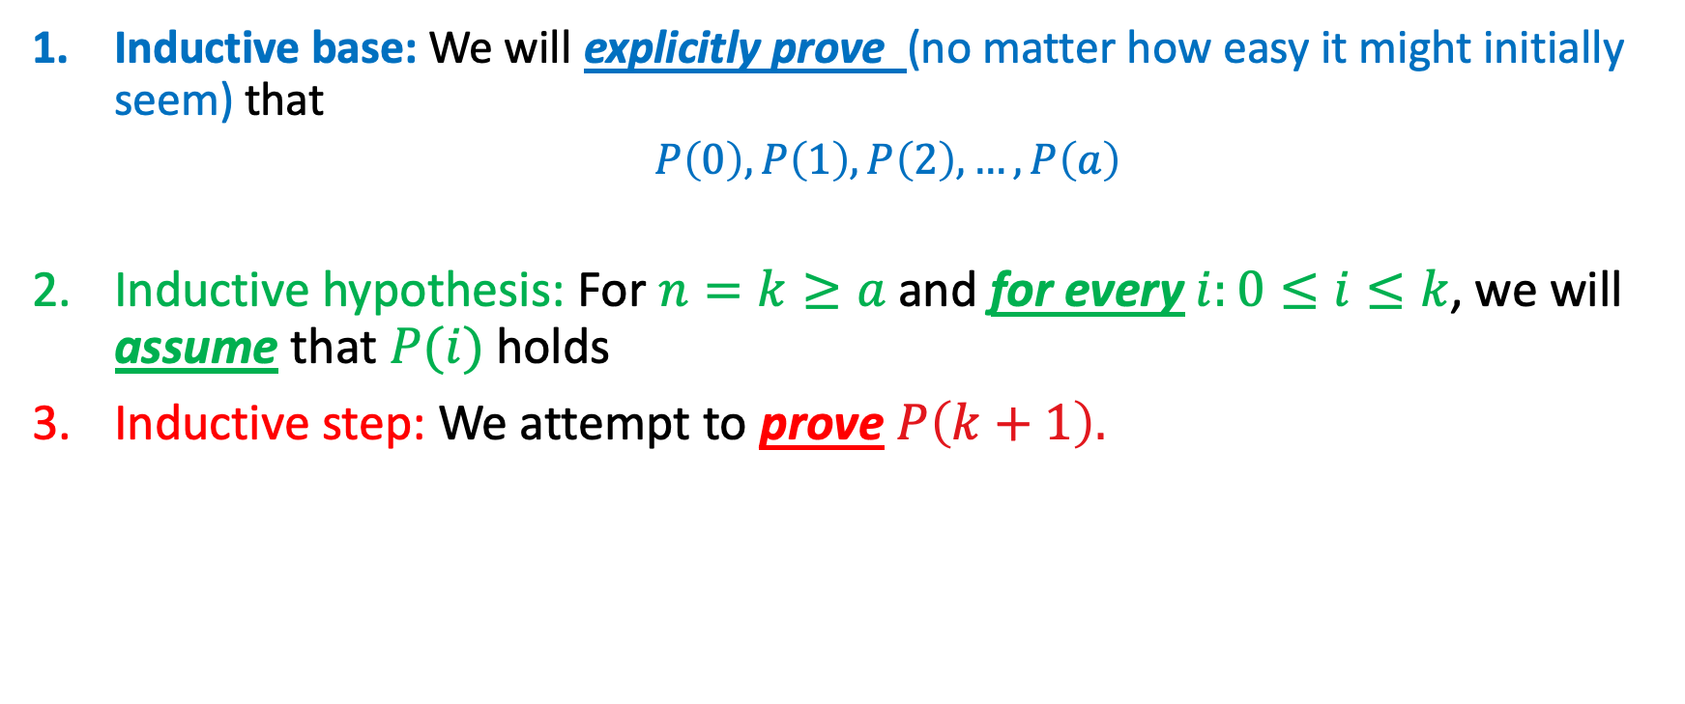
How we’ll make it work
Inductive base: We will explicitly prove (no matter how easy it might initially seem) that
$P\left(0\right), P\left(1\right), P\left(2\right), …, P\left(a\right)$
Inductive hypothesis: For $n=k≥a$ and for every $i:0≤i≤k$, we will assume that $P(i)$ holds
Inductive step: We attempt to prove $P\left(k+1\right).$
3
…
a
…
k
k+1
$$k+2$$
…
$$…$$
$$−2$$
$$−1$$
$$0$$
$$1$$
$$2$$
“Safety Net” Extended!

Slide 28

How we’ll make it work
Inductive base: We will explicitly prove (no matter how easy it might initially seem) that
$P\left(0\right), P\left(1\right), P\left(2\right), …, P\left(a\right)$
Inductive hypothesis: For $n=k≥a$ and for every $i:0≤i≤k$, we will assume that $P(i)$ holds
Inductive step: We attempt to prove $P\left(k+1\right).$
Note that we assume
$P\left(0\right)∧P\left(1\right)∧…∧P(k)$ !
3
…
a
…
k
k+1
$$k+2$$
…
$$…$$
$$−2$$
$$−1$$
$$0$$
$$1$$
$$2$$
“Safety Net” Extended!

Slide 29

How we’ll make it work
Inductive base: We will explicitly prove (no matter how easy it might initially seem) that
$P\left(0\right), P\left(1\right), P\left(2\right), …, P\left(a\right)$
Inductive hypothesis: For $n=k≥a$ and for every $i:0≤i≤k$, we will assume that $P(i)$ holds
Inductive step: We attempt to prove $P\left(k+1\right).$
But, by the inductive principle, this means that we can expand our net some more…
3
…
a
…
k
k+1
$$k+2$$
…
$$…$$
$$−2$$
$$−1$$
$$0$$
$$1$$
$$2$$

Slide 30



How we’ll make it work
Inductive base: We will explicitly prove (no matter how easy it might initially seem) that
$P\left(0\right), P\left(1\right), P\left(2\right), …, P\left(a\right)$
Inductive hypothesis: For $n=k≥a$ and for every $i:0≤i≤k$, we will assume that $P(i)$ holds
Inductive step: We attempt to prove $P\left(k+1\right).$
But, by the inductive principle, this means that we can expand our net some more…
And prove the statement for $k+2$
3
…
a
…
k
k+1
$$k+2$$
$$k+3$$
$$…$$
$$−2$$
$$−1$$
$$0$$
$$1$$
$$2$$

Slide 31



How we’ll make it work
Inductive base: We will explicitly prove (no matter how easy it might initially seem) that
$P\left(0\right), P\left(1\right), P\left(2\right), …, P\left(a\right)$
Inductive hypothesis: For $n=k≥a$ and for every $i:0≤i≤k$, we will assume that $P(i)$ holds
Inductive step: We attempt to prove $P\left(k+1\right).$
But, by the inductive principle, this means that we can expand our net some more…
And prove the statement for $k+2, k+3$, …
3
…
a
…
k
k+1
$$k+2$$
$$k+3$$
$$…$$
$$−2$$
$$−1$$
$$0$$
$$1$$
$$2$$

Slide 32
Utility of strong induction
Enormous
Correctness of algorithms
Growth of structures like trees, graphs, lists, strings, sets

Slide 33
Utility of strong induction
Enormous
Correctness of algorithms
Growth of structures like trees, graphs, lists, strings, sets
Terrifically useful in sequences
Helps us reach closed – form formulae for recursively defined sequences!

Slide 34

A first example
Let $a$ be a sequence such that:
$$a_{n}= \left\{\begin{aligned}1, n=0 \\ 8, n=1 \\ a_{n−1}+2⋅a_{n−2}, n≥2\end{aligned}\right.$$
Prove that $a_{n}=3⋅2^{n}+2{\left(−1\right)}^{n+1} , n∈ℕ^{ }$

Slide 35


A first example
Let $a$ be a sequence such that:
$$a_{n}= \left\{\begin{aligned}1, n=0 \\ 8, n=1 \\ a_{n−1}+2⋅a_{n−2}, n≥2\end{aligned}\right.$$
Prove that $a_{n}=3⋅2^{n}+2{\left(−1\right)}^{n+1} , n∈ℕ^{ }$
How many elements in my inductive base?
$$P\left(n\right)$$
1
2
3
Something
Else

Slide 36

A first example
Let $a$ be a sequence such that:
$$a_{n}= \left\{\begin{aligned}1, n=0 \\ 8, n=1 \\ a_{n−1}+2⋅a_{n−2}, n≥2\end{aligned}\right.$$
Prove that $a_{n}=3⋅2^{n}+2{\left(−1\right)}^{n+1} , n∈ℕ^{ }$
How many elements in my inductive base?
$$P\left(n\right)$$
1
2
3
Something
Else
Notes:
Make a note here about how we are given the closed-form formula and we are trying to prove that it exactly represents the sequence (i.e it’s not an upper bound)

Slide 37



Inductive base
$$a_{n}= \left\{\begin{aligned}1, n=0 \\ 8, n=1 \\ a_{n−1}+2⋅a_{n−2}, n≥2\end{aligned}\right.$$
$$P\left(n\right)⇔a_{n}=3⋅2^{n}+2{\left(−1\right)}^{n+1}$$
For $n=0$, $a_{0}=1$ by the definition of $a.$ $P(0)$ says: $a_{0}=3⋅2^{0}+2{\left(−1\right)}^{1}=3−2=1$. So $P(0)$ holds.
For ${\text{n}\text{ = 1,} a}_{1}=8$ by the definition of $a$. $P(1)$ says: $a_{1}=3⋅2^{1}+2{\left(−1\right)}^{2}=6+2=8.$
So P(1) holds.

Slide 38

Inductive base
$$a_{n}= \left\{\begin{aligned}1, n=0 \\ 8, n=1 \\ a_{n−1}+2⋅a_{n−2}, n≥2\end{aligned}\right.$$
$$P\left(n\right)⇔a_{n}=3⋅2^{n}+2{\left(−1\right)}^{n+1}$$
For $n=0$, $a_{0}=1$ by the definition of $a.$ $P(0)$ says: $a_{0}=3⋅2^{0}+2{\left(−1\right)}^{1}=3−2=1$. So $P(0)$ holds.
For ${\text{n}\text{ = 1,} a}_{1}=8$ by the definition of $a$. $P(1)$ says: $a_{1}=3⋅2^{1}+2{\left(−1\right)}^{2}=6+2=8.$
So P(1) holds.
Inductive Base established!

Slide 39






Inductive Hypothesis
$$P($$
$$)$$
$$P($$
$$)$$
$$0$$
1
$$a_{n}= \left\{\begin{aligned}1, n=0 \\ 8, n=1 \\ a_{n−1}+2⋅a_{n−2}, n≥2\end{aligned}\right.$$
$$P\left(n\right)⇔a_{n}=3⋅2^{n}+2{\left(−1\right)}^{n+1}$$
Suppose $n=k≥1.$ Then, $∀i∈\{0, 1, …, k\}$ assume $P\left(i\right),$ i.e
$a_{i}=3⋅2^{i}+2{\left(−1\right)}^{i+1}, i=0, 1, …, k$

Slide 40


Inductive Hypothesis
$$P($$
$$)$$
$$P($$
1
$$)$$
$$0$$
$$a_{n}= \left\{\begin{aligned}1, n=0 \\ 8, n=1 \\ a_{n−1}+2⋅a_{n−2}, n≥2\end{aligned}\right.$$
$$P\left(n\right)⇔a_{n}=3⋅2^{n}+2{\left(−1\right)}^{n+1}$$
Suppose $n=k≥1.$ Then, $∀i∈\{0, 1, …, k\}$ assume $P\left(i\right),$ i.e
$a_{i}=3⋅2^{i}+2{\left(−1\right)}^{i+1}, i=0, 1, …, k$
Inductive Hypothesis made!

Slide 41


Inductive Step
$$P($$
$$)$$
$$P($$
$$)$$
$$0$$
1
$$a_{n}= \left\{\begin{aligned}1, n=0 \\ 8, n=1 \\ a_{n−1}+2⋅a_{n−2}, n≥2\end{aligned}\right.$$
$$P\left(n\right)⇔a_{n}=3⋅2^{n}+2{\left(−1\right)}^{n+1}$$
We will now prove $P\left(k+1\right)$, i.e
$$a_{k+1}=3⋅2^{k+1}+2{\left(−1\right)}^{k+2}$$
$$P\left(i\right) ∀i=0,1, …k$$

Slide 42


Inductive Step
$$P($$
$$)$$
$$P($$
$$)$$
$$0$$
1
$$a_{n}= \left\{\begin{aligned}1, n=0 \\ 8, n=1 \\ a_{n−1}+2⋅a_{n−2}, n≥2\end{aligned}\right.$$
$$P\left(n\right)⇔a_{n}=3⋅2^{n}+2{\left(−1\right)}^{n+1}$$
Since $k≥1⇒\left(k+1\right)≥2,$ we can apply the recursive rule of the sequence.
From the recursive definition of $a_{n}$, we obtain:
$$a_{k+1}=a_{k}+2⋅a_{k−1}\overset{I.H}{=}3⋅2^{k }+2{\left(−1\right)}^{k+1}+2⋅\left(3⋅2^{k−1}+2 {\left(−1\right)}^{k}\right)= \\ =3⋅\left(2^{k}+2⋅2^{k−1}\right)+2⋅{\left(−1\right)}^{k}[−1+2]=$$ $=3⋅\left(2⋅2^{k}\right) \text{+} 2⋅{\left(−1\right)}^{k}=3⋅2^{k+1}+2{\left(−1\right)}^{k+2}$
$$P\left(i\right) ∀i=0,1, …k$$
My goal: Prove $P\left(k+1\right): a_{k+1}=3⋅2^{k+1}+2{\left(−1\right)}^{k+2}$

Slide 43

Inductive Step
$$P($$
$$)$$
$$P($$
$$)$$
$$0$$
1
$$a_{n}= \left\{\begin{aligned}1, n=0 \\ 8, n=1 \\ a_{n−1}+2⋅a_{n−2}, n≥2\end{aligned}\right.$$
$$P\left(n\right)⇔a_{n}=3⋅2^{n}+2{\left(−1\right)}^{n+1}$$
Since $k≥1⇒\left(k+1\right)≥2,$ we can apply the recursive rule of the sequence.
From the recursive definition of $a_{n}$, we obtain:
$$a_{k+1}=a_{k}+2⋅a_{k−1}\overset{I.H}{=}3⋅2^{k }+2{\left(−1\right)}^{k+1}+2⋅\left(3⋅2^{k−1}+2 {\left(−1\right)}^{k}\right)= \\ =3⋅\left(2^{k}+2⋅2^{k−1}\right)+2⋅{\left(−1\right)}^{k}[−1+2]=$$ $=3⋅\left(2⋅2^{k}\right) \text{+} 2⋅{\left(−1\right)}^{k}=3⋅2^{k+1}+2{\left(−1\right)}^{k+2}$
$$P\left(i\right) ∀i=0,1, …k$$
My goal: Prove $P\left(k+1\right): a_{k+1}=3⋅2^{k+1}+2{\left(−1\right)}^{k+2}$
Inductive step proven!

Slide 44

Inductive Step
$$P($$
$$)$$
$$P($$
$$)$$
$$0$$
1
$$a_{n}= \left\{\begin{aligned}1, n=0 \\ 8, n=1 \\ a_{n−1}+2⋅a_{n−2}, n≥2\end{aligned}\right.$$
$$P\left(n\right)⇔a_{n}=3⋅2^{n}+2{\left(−1\right)}^{n+1}$$
Since $k≥1⇒\left(k+1\right)≥2,$ we can apply the recursive rule of the sequence.
From the recursive definition of $a_{n}$, we obtain:
$$a_{k+1}=a_{k}+2⋅a_{k−1}\overset{I.H}{=}3⋅2^{k }+2{\left(−1\right)}^{k+1}+2⋅\left(3⋅2^{k−1}+2 {\left(−1\right)}^{k}\right)= \\ =3⋅\left(2^{k}+2⋅2^{k−1}\right)+2⋅{\left(−1\right)}^{k}[−1+2]=$$ $=3⋅\left(2⋅2^{k}\right) \text{+} 2⋅{\left(−1\right)}^{k}=3⋅2^{k+1}+2{\left(−1\right)}^{k+2}$
$$P\left(i\right) ∀i=0,1, …k$$
My goal: Prove $P\left(k+1\right): a_{k+1}=3⋅2^{k+1}+2{\left(−1\right)}^{k+2}$
Proof done!

Slide 45

Here’s another
Suppose that the sequence $a_{n}$ is as follows:
$$a_{n}=\left\{\begin{aligned}12, n=0 \\ 29, n=1 \\ 5a_{n−1}−6a_{n−2}, n≥2\end{aligned}\right.$$
Then, prove that $a_{n}=5⋅3^{n}+7⋅2^{n}, ∀n∈ℕ$

Slide 46

Inductive base
Let the statement to be proven be called $P(n)$. We proceed via strong induction on $n$.
Inductive base: We want to prove $P\left(0\right), P(1)$.
For $n=0, P\left(0\right)$ is $s_{0}=5⋅3^{0}+7⋅2^{0}⇔12=12$
For $n=1, P\left(1\right)$is$s_{1}=5⋅3^{1}+7⋅2^{1}⇔29=15+14$
So the inductive base has been established!

Slide 47

Inductive hypothesis
Inductive Hypothesis: Let $n=k≥1$. Then, we assume that, for all $i=0,1,…, k, P\left(i\right)$ holds, i.e
$a_{i}=$ $5⋅3^{i}+7⋅2^{i}, i=0,1,…,k$

Slide 48

Inductive Step
Inductive Step: We will attempt to prove $P(k+1)$, i.e
$$a_{k+1}=5⋅3^{k+1}\text{+ 7}⋅2^{k+1}$$

Slide 49

Inductive Step
Inductive Step: We will attempt to prove $P(k+1)$, i.e
$$a_{k+1}=5⋅3^{k+1}\text{+ 7}⋅2^{k+1}$$
Since $\left(k≥1\right), (k+1≥2)$ and we can use the recursive definition of $a$.
From the recursive definition of $a$ we have:
$$a_{k+1}=5a_{k}−6a_{k−1}\overset{I.H}{=}5\left(5⋅3^{k}+7⋅2^{k}\right)−6\left(5⋅3^{k−1}+7⋅2^{k−1}\right)=25⋅3^{k}+35⋅2^{k}−30⋅3^{k−1}−42⋅2^{k−1}=5⋅\left(5⋅3^{k}−2⋅3^{k}\right)+7\left(5⋅2^{k}−3⋅2^{k}\right)=5⋅3^{k+1}+7⋅2^{k+1} □$$

Slide 50

Inductive Step
Inductive Step: We will attempt to prove $P(k+1)$, i.e
$$a_{k+1}=5⋅3^{k+1}\text{+ 7}⋅2^{k+1}$$
Since $\left(k≥1\right), (k+1≥2)$ and we can use the recursive definition of $a$.
From the recursive definition of $a$ we have:
$$a_{k+1}=5a_{k}−6a_{k−1}\overset{I.H}{=}5\left(5⋅3^{k}+7⋅2^{k}\right)−6\left(5⋅3^{k−1}+7⋅2^{k−1}\right)=25⋅3^{k}+35⋅2^{k}−30⋅3^{k−1}−42⋅2^{k−1}=5⋅\left(5⋅3^{k}−2⋅3^{k}\right)+7\left(5⋅2^{k}−3⋅2^{k}\right)=5⋅3^{k+1}+7⋅2^{k+1} □$$
Since we need factors of 5 and 7 in our result, we force them to appear and our lives automatically become easier!

Slide 51

A sequence problem for you!
Let $a_{n}$ be defined as:
$$a_{n}=\left\{\begin{aligned}5, n=0 \\ 16, n=1 \\ 7a_{n−1}−10a_{n−2}, n≥2\end{aligned}\right.$$
Prove that $a_{n}=3⋅2^{n}+2⋅5^{n}$

Slide 52

Existence part of UFT
Recall the statement of UFT: For any integer $n≥2$, there exist unique $p_{i}∈P, e_{i}∈ℕ^{≥1}$ such that:
$$n=\prod_{i=0}^{r}{p_{i}^{e_{i}}}$$
We will prove the existence part, i.e that
$$\left(∀n≥2\right)(∃p_{i}∈P,e_{i}∈ℕ^{≥1})[n=\prod_{i=0}^{r}{p_{i}^{e_{i}}}]$$
Notes:
Maybe point out the difference between the book’s first proof and this elegant proof.

Slide 53


Existence part of UFT
Recall the statement of UFT: For any integer $n≥2$, there exist unique $p_{i}∈P, e_{i}∈ℕ^{≥1}$ such that:
$$n=\prod_{i=0}^{r}{p_{i}^{e_{i}}}$$
We will prove the existence part, i.e that
$$\left(∀n≥2\right)(∃p_{i}∈P,e_{i}∈ℕ^{≥1})[n=\prod_{i=0}^{r}{p_{i}^{e_{i}}}]$$
So it’s an existential question, the affirmative of which we will prove constructively, via induction!
Notes:
Maybe point out the difference between the book’s first proof and this elegant proof.

Slide 54

Proof
IB: For $n=2$, $2=2^{1}$, so $\left(∃p_{1}∈P, e_{1}∈ℕ^{≥1}\right)[2=p_{1}^{e_{1}}]$. Done.
I.H: Suppose $n=k≥2$. Then, assume that
$\left(∀j∈\left\{2, 3, …,k\right\}\right)\left(∃p_{i}∈P, e_{i}∈ℕ^{≥1}\right)[k=\prod_{i=0}^{r}{p_{i}^{e_{i}}]}$
I.S: We will now prove $P(k+1)$, i.e that
$$\left(∃p_{i}^{′}∈P, e_{i}^{′}∈ℕ^{≥1}\right)[k+1=\prod_{i=0}^{r}{p_{i}^{′^{e_{i}^{′}}}]}$$

Slide 55

Proof
IB: For $n=2$, $2=2^{1}$, so $\left(∃p_{1}∈P, e_{1}∈ℕ^{≥1}\right)[2=p_{1}^{e_{1}}]$. Done.
I.H: Suppose $n=k≥2$. Then, assume that
$\left(∀j∈\left\{2, 3, …,k\right\}\right)\left(∃p_{i}∈P, e_{i}∈ℕ^{≥1}\right)[k=\prod_{i=0}^{r}{p_{i}^{e_{i}}]}$
I.S: We will now prove $P(k+1)$, i.e that
$$\left(∃p_{i}^{′}∈P, e_{i}^{′}∈ℕ^{≥1}\right)[k+1=\prod_{i=0}^{r}{p_{i}^{′^{e_{i}^{′}}}]}$$
Case #1: $k+1∈P$. Then, $p_{1}^{′}=k+1, e_{1}=1$. Done.
Case #2: $k+1∉P$. Then, $\left(∃ℓ_{1}, ℓ_{2}∈\{2, 3, …,k\}\right)[k+1=ℓ_{1}⋅ℓ_{2}]$
Inductive step contd. in next slide for readability…

Slide 56

Inductive step (contd.)
Case #2: $k+1∉P$. Then, $\left(∃ℓ_{1}, ℓ_{2}∈\{2, 3, …,k\}\right)[k+1=ℓ_{1}⋅ℓ_{2}]$

Slide 57

Inductive step (contd.)
Case #2: $k+1∉P$. Then, $\left(∃ℓ_{1}, ℓ_{2}∈\{2, 3, …,k\}\right)[k+1=ℓ_{1}⋅ℓ_{2}]$
By the Inductive Hypothesis,
$\left(∃q_{i}∈P, s_{i}∈ℕ^{≥1}\right)[ℓ_{1}=\prod_{i=0}^{m_{1}}{q_{i}^{e_{i}}}]$
and
$\left(∃q_{i}^{′}∈P, s_{i}^{′}∈ℕ^{≥1}\right)[ℓ_{2}=\prod_{i=0}^{m_{2}}{q_{ i}^{′^{e_{i}^{′}}}}]$

Slide 58

Inductive step (contd.)
Case #2: $k+1∉P$. Then, $\left(∃ℓ_{1}, ℓ_{2}∈\{2, 3, …,k\}\right)[k+1=ℓ_{1}⋅ℓ_{2}]$
By the Inductive Hypothesis,
$\left(∃q_{i}∈P, s_{i}∈ℕ^{≥1}\right)[ℓ_{1}=\prod_{i=0}^{m_{1}}{q_{i}^{e_{i}}}]$
and
$\left(∃q_{i}^{′}∈P, s_{i}^{′}∈ℕ^{≥1}\right)[ℓ_{2}=\prod_{i=0}^{m_{2}}{q_{ i}^{′^{e_{i}^{′}}}}]$
Therefore,
$$k+1=\prod_{i=0}^{max⁡\{m_{1},m_{2}\}}{q_{i}^{e_{i}}⋅q_{ i}^{′^{e_{i}^{′}}}}$$
which is a unique product of prime powers. Done.

Slide 59

Important note
Recall case #2: $k+1∉P$. Then, $\left(∃ℓ_{1}, ℓ_{2}∈\{2, 3, …,k\}\right)[k+1=ℓ_{1}⋅ℓ_{2}]$
Note that $P(k+1)$ depends on falling back to the assumed $P\left(ℓ_{1}\right), P(ℓ_{2})$.

Slide 60

Important note
In our proofs on recurrences, $P(k+1)$ dependent on stuff such as
$$P\left(k\right), P\left(k−1\right), P\left(k−2\right), …$$
It is possible (and common) for $P(k+1)$ to depend on
$$P\left({(k+1)}/2\right),P\left({(k+1)}/3\right), P(\sqrt{k+1})…$$
Example: Case #2 of existence part of UPFT depends on two integers $ℓ_{1},ℓ_{2}$ whose product is $k+1$
It must be the case that $2≤ℓ_{1},ℓ_{2}≤\left\lfloor \sqrt{k+1 }\right\rfloor ≤k$

Slide 61






Important note
In our proofs on recurrences, $P(k+1)$ dependent on stuff such as
$$P\left(k\right), P\left(k−1\right), P\left(k−2\right), …$$
It is possible (and common) for $P(k+1)$ to depend on
$$P\left({(k+1)}/2\right),P\left({(k+1)}/3\right), P(\sqrt{k+1})…$$
Example: Case #2 of existence part of UPFT depends on two integers $ℓ_{1},ℓ_{2}$ whose product is $k+1$
It must be the case that $2≤ℓ_{1},ℓ_{2}≤\left\lfloor \sqrt{k+1 }\right\rfloor ≤k<k+1$
2
3
4
…
$$ℓ_{1}$$
…
$$ℓ_{2}$$
…
$$\left\lfloor \sqrt{k+1 }\right\rfloor$$
…
$$k$$
$$k+1$$

